Slide 1


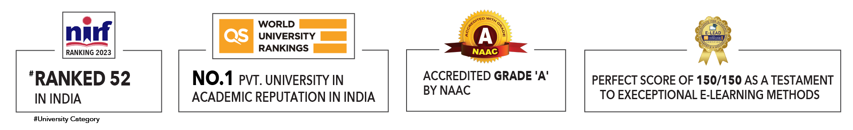

Slide 2

Unit 4 : Reinforcement Learning
Lecture 5
Submitted by:
Dr Archana Kumari
School of Computer Science UPES, Dehradun
India

Slide 3
Table of Contents
Reinforcement Learning with Example
What is Reinforcement Learning?
Key Concepts in RL
Reinforcement Learning Concepts
Types of Reinforcement Learning
Markov Decision Process
Reinforcement Learning Algorithms
Real-Life Examples
Basic Algorithms

Slide 4
Learning & Course Outcomes
LO1: Define reinforcement learning and its components: states, actions, rewards, and policies.
LO2: Explain the role of agents in reinforcement learning and their interaction with the environment.
LO3: Apply reinforcement learning algorithms, such as Q-learning and policy gradients, to solve basic problems.
CO2: Understand the basics of Machine Learning and its types.

Slide 5
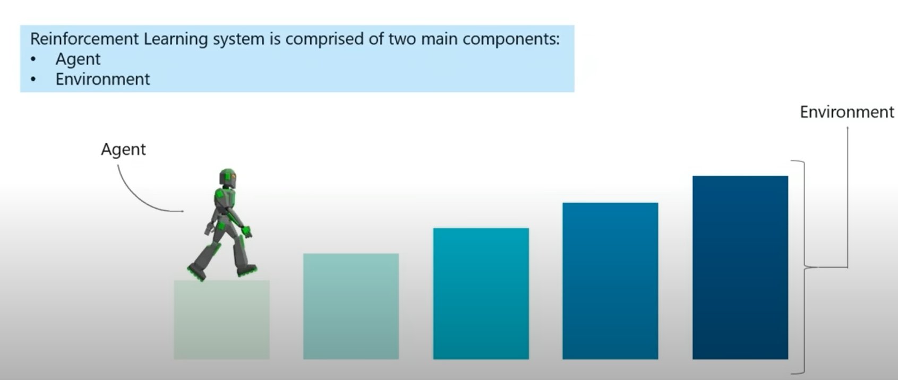
Reinforcement Learning

Slide 6
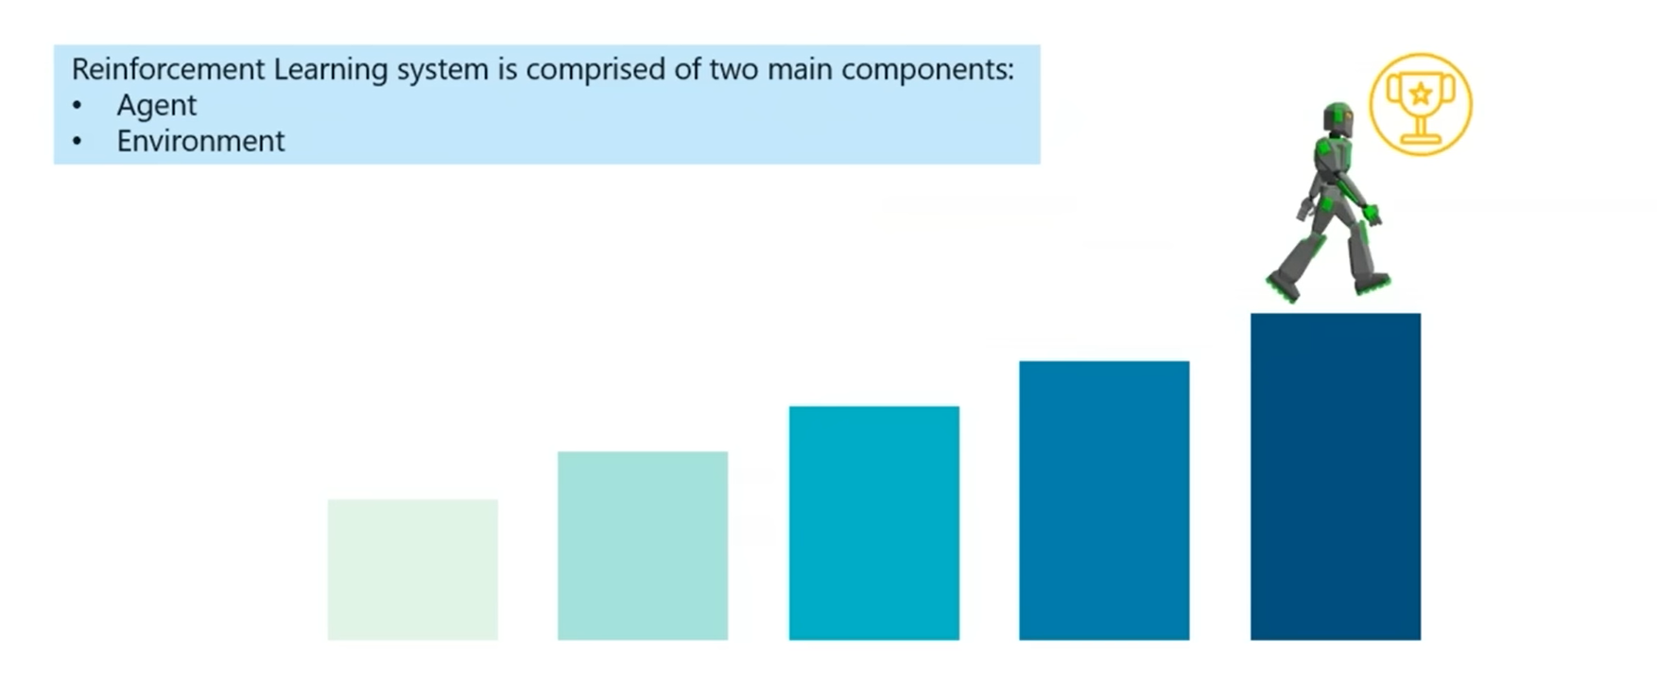
Reinforcement Learning

Slide 7

Reinforcement Learning Example
The RL Agent(Player 1)collects the state $S^{0}$from the environment
Based on the state $S^{0}$, the RL agent takes an action $A^{0}$.Initially, the action is random.
The environment is now in a new state $S^{1}$.
The RL agent now gets the Reward $R^{1}$ from the Environment.
The RL loop goes until the RL agent is dead or reaches the destination.

Slide 8
What is Reinforcement Learning?
Reinforcement learning
Definition: A type of machine learning where an agent learns to make decisions by performing actions in an environment to maximize cumulative reward.
Key Idea: Trial and error learning with feedback.

Slide 9
Key Concepts in RL
Agent: The learner or decision-maker. The RL Algorithm learns from trial and Error.
Environment: The world through which the agent interacts.
Action (A): Possible moves the agent can make.
State (S): The current situation. Current condition returned by the Environment.
Reward (R): Feedback from the environment. An instant return from the Environment to appraise the last action.
Policy (π): Strategy to decide the next action. The approach that the agent uses to determine the next action based on current state.

Slide 10
Key Concepts in RL
Value Function: Evaluates the goodness of states or actions. The expected long term-return with discount, as opposed to short term reward R.
Action-Value: This is similar to Value, except it takes an extra parameter, the current Action(A).

Slide 11
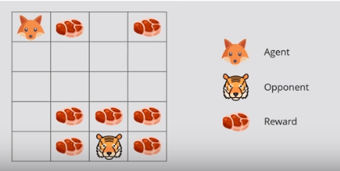
Reinforcement Learning Concepts
Reward Maximization: Reward Maximization theory states that, an RL agent must be trained in such a way that, he takes the best action so that the reward is maximum.
End Goal: To eat the maximum amount of meat before being eaten by Tiger.
Discounting: The agent would not eat the chunks closer to the tiger, even though they are larger.
The discounting of rewards works based on a value called Gamma(𝛾). If the value of Gamma(𝛾) is lower, this means the agent is not going to explore and eat the chunks closer to the opponent, in order to avoid the risk.

Slide 12
Exploration versus Exploitation
Exploitation: involves using the already known information to heighten the rewards.
Exploration:means exploring and capturing more information about the environment.
Exploitation: For example, the fox eats the meat chunks close to itself instead of going closer to the tiger and eating the larger chunks.
Exploration: if the agent decides to explore the whole environment and attain maximum rewards, that would fall under exploration.

Slide 13
Exploration versus Exploitation
We want a reinforcement learning agent to earn lots of rewards.
The agent must prefer past actions that have been found to be effective at producing reward.
The agent must exploit what it already knows to obtain reward.
The agent must select untested actions to discover reward-producing actions.
The agent must explore actions to make better action selections in the future.
Trade-off between exploration and exploitation.

Slide 14
Types of Reinforcement Learning
There are mainly two types of reinforcement learning, which are:
Positive Reinforcement
Positive reinforcement learning means adding something to increase the tendency of the expected behavior to occur again. It positively impacts the behaviour of the agent and increases the strength of the behaviour.
This type of reinforcement can sustain the changes for a long time, but too much positive reinforcement may lead to an overload of states that can reduce the consequences.
Negative Reinforcement
The negative reinforcement learning is opposite to the positive reinforcement as it increases the tendency that the specific behavior will occur again by avoiding the negative condition.
It can be more effective than the positive reinforcement depending on situation and behavior, but it provides reinforcement only to meet minimum behavior.

Slide 15
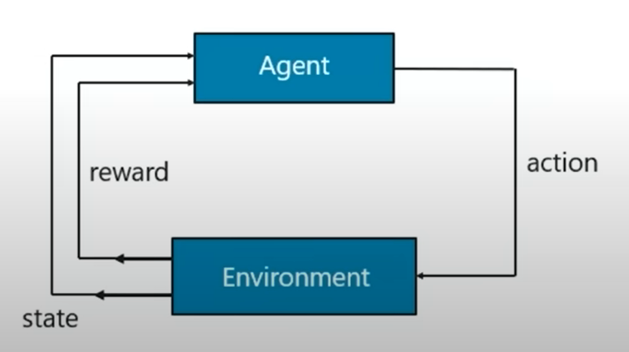
Markov Decision Process
The mathematical approach of mapping a solution in reinforcement learning is called Markov Decision Process (MDP).
The following parameters are used to attain a solution:
Set of actions, A, an agent can choose to take.
Set of states, S.
Reward, R, accumulated by the actions of the agent.
Policy, π.
Value, V.

Slide 16
Markov Decision Process
Markov Property
Transition: Moving from one state to another is called a transition.
Transition Probability: The probability that the agent will move from one state to another is called the transition probability.
The Markov Property states that:
“Future is independent of the past given the present”. A system has Markov Property associated with its states then the state transition depends upon the current state and current action of the system and not on the entire trajectory and actions that happened in the past.

Slide 17

Markov Decision Process
Mathematically, we can express this statement as :
$$P\left[S_{t+1} | { S}_{t}\right]=P\left[S_{t+1} | { S}_{1} , ………, S_{t}\right]$$
S[t] : current state of the agent
s[t+1] : the next state.
The equation represents that the transition from state S[t] to S[t+1] is entirely independent of the past.
State Transition Probability: Having known about transition probabilities, we can define the state transition probability as follows: For Markov State from S[t] to S[t+1] i.e. any other successor state , the state transition probability is given by:
$$P_{ss^{′}}= P\left[S_{t+1}=s^{′} | S_{t}=s^{ }\right]$$

Slide 18
Reinforcement Learning Algorithms
Model-based reinforcement learning
Dyna-Q
Model-free reinforcement learning
Q-Learning
SARSA (State-Action-Reward-State-Action)
Policy gradient methods
Deep Q-Networks (DQN)

Slide 19
Model-free versus Model-based Learning
A model of the environment allows inferences to be made about how the environment will behave
Example: Given a state and an action to be taken while in that state, the model could predict the next state and the next reward
Models are used for planning, which means deciding on a course of action by considering possible future situations before they are experienced
Model-based methods use models and planning. Think of this as modelling the dynamics p(s’ | s, a)
Model-free methods learn exclusively from trial-and-error (i.e. no modelling of the environment)
This presentation focuses on model-free methods

Slide 20
Basic Algorithm: Q-Learning
Definition: A method to find the optimal action-selection policy using the Bellman equation.
Q-Value: Quality of a state-action combination.
Formula: Q(s, a) = Q(s, a) + α [R + γ max Q(s', a') - Q(s, a)]
α: Learning rate
γ: Discount factor
R: Reward
s': Next state

Slide 21
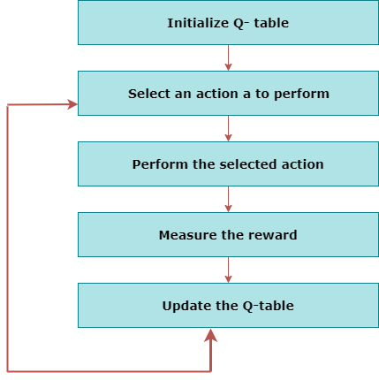
Basic Algorithm: Q-Learning
Q-Learning:
Q-learning is an Off-policy RL algorithm, which is used for the temporal difference Learning.
The temporal difference learning methods are a way of comparing temporally successive predictions.
It learns the value function Q (S, a), which means how good to take action "a" at a particular state "s.“
The flowchart explains the working of Q- learning:

Slide 22
How Q-Learning Works
Initialize Q-values arbitrarily for all state-action pairs.
Repeat (for each episode):
Observe current state (s).
Choose an action (a) based on policy (e.g., ε-greedy).
Take action (a), observe reward (R) and next state (s').
Update Q-value using formula.
Transition to next state (s').

Slide 23
State Action Reward State action (SARSA)
SARSA stands for State Action Reward State action, which is an on-policy temporal difference learning method. The on-policy control method selects the action for each state while learning using a specific policy.
The goal of SARSA is to calculate the Q π (s, a) for the selected current policy π and all pairs of (s-a).
The main difference between Q-learning and SARSA algorithms is that unlike Q-learning, the maximum reward for the next state is not required for updating the Q-value in the table.
In SARSA, new action and reward are selected using the same policy, which has determined the original action.
The SARSA is named because it uses the quintuple Q(s, a, r, s', a’).
s: original state a: Original action r: reward observed while following the states s' and a': New state, action pair.

Slide 24
Deep Q-Networks (DQN)
Introduced deep reinforcement learning
It is common to use a function approximator Q(s, a; θ) to approximate the action-value function in Q-learning
Deep Q-Networks is Q-learning with a deep neural network function approximator called the Q-network
Discrete and finite set of actions A
Uses epsilon-greedy policy to select actions

Slide 25
Q-Networks
Core idea: We want the neural network to learn a non-linear hierarchy of features or feature representation that gives accurate Q-value estimates
The neural network has a separate output unit for each possible action, which gives the Q-value estimate for that action given the input state
The neural network is trained using mini-batch stochastic gradient updates and experience replay

Slide 26
Experience Replay
The state is a sequence of actions and observations s_{t} = x₁, a₁, x₂, …, a_{t-1}, x_{t}
Store the agent’s experiences at each time step e_{t} = (s_{t}, a_{t}, r_{t}, s_{t+1}) in a dataset D = e₁, ..., e_{n} pooled over many episodes into a replay memory
In practice, only store the last N experience tuples in the replay memory and sample uniformly from D when performing updates

Slide 27
State representation
It is difficult to give the neural network a sequence of arbitrary length as input
Use fixed length representation of sequence/history produced by a function ϕ(s_{t})

Slide 28
Q-Network Training
Sample random mini-batch of experience tuples uniformly at random from D
Similar to Q-learning update rule but:
Use mini-batch stochastic gradient updates
The gradient of the loss function for a given iteration with respect to the parameter θ_{i} is the difference between the target value and the actual value is multiplied by the gradient of the Q function approximator Q(s, a; θ) with respect to that specific parameter
Use the gradient of the loss function to update the Q function approximator

Slide 29
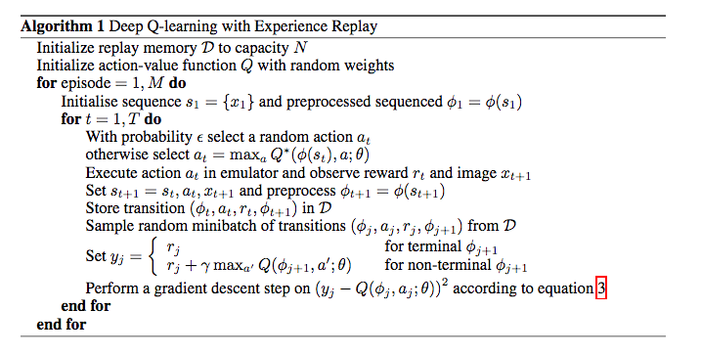
DQN Algorithm

Slide 30
Real-Life Examples
Video Games: AI in games like chess, Go.
Robotics: Robots learning tasks (e.g., walking, picking objects).
Autonomous Vehicles: Self-driving cars making driving decisions.
Finance: Algorithms trading stocks or managing investments.
Healthcare: Treatment planning using patient outcome data.

Slide 31
Practical Example: Self-Driving Car
State: Position of the car, speed, traffic conditions.
Actions: Accelerate, brake, turn left, turn right.
Reward: Reaching destination, avoiding collisions, maintaining speed limit.
Learning Process: The car continuously improves its driving policy by interacting with the environment.

Slide 32
Summary
Definition of Reinforcement Learning: A type of machine learning where an agent learns to make decisions by performing actions in an environment to maximize cumulative reward.
Key Components: Agent, environment, actions, states, rewards, and policies.
Reward Maximization: Training the agent to take actions that maximize cumulative rewards, with a focus on balancing exploration and exploitation.
Types of Reinforcement Learning: Positive reinforcement (adding positive stimuli) and negative reinforcement (removing negative stimuli).
Markov Decision Process (MDP): A mathematical framework involving actions, states, rewards, policies, and values based on the Markov property.

Slide 33
Summary
Reinforcement Learning Algorithms: Includes model-based and model-free approaches, with key algorithms like Q-learning and SARSA.
Q-Learning: An off-policy algorithm that updates the value of action-state pairs using the Bellman equation.
Real-Life Applications: Examples include AI in video games, robotics, self-driving cars, financial trading algorithms, and healthcare treatment planning.

Slide 34
Reference Material
Silberschatz, A., Galvin, P. B., & Gagne, G. (2006). Operating system principles. John Wiley & Sons.
https://www.javatpoint.com/reinforcement-learning
https://www.datacamp.com/tutorial/reinforcement-learning-python-introduction
https://towardsdatascience.com/reinforcement-learning-made-simple-part-1-intro-to-basic-concepts-and-terminology-1d2a87aa060
https://heartbeat.comet.ml/introduction-to-reinforcement-learning-a91beec7f830

Slide 35
MCQ’s
What is 'exploration' in the context of reinforcement learning?
A. Using the current best-known action to maximize reward
B. Trying out new actions to discover their effects
C. Calculating the expected return of an action
D. Training a model on historical data
Which algorithm is typically used in reinforcement learning to estimate the value of actions?
A. K-means clustering
B. Q-learning
C. Principal Component Analysis (PCA)
D. Gradient Descent
What is the 'reward signal' in reinforcement learning?
A. A measure of the immediate benefit received after taking an action
B. The difference between the predicted and actual rewards
C. A penalty for incorrect actions
D. The final score obtained after an episode

Slide 36
MCQ’s
4. In the context of reinforcement learning, what is 'discount factor'?
A. A parameter that scales the learning rate
B. A factor that reduces the value of future rewards
C. A constant used to penalize certain actions
D. A method to normalize state values
5. Which of the following statements best describes 'temporal difference learning'?
A. It is a method for estimating the value of states by looking ahead multiple steps
B. It is a hybrid method that combines Monte Carlo methods and dynamic programming
C. It is a method used to minimize the difference between predicted and actual rewards
D. It is a supervised learning method for training neural networks

Slide 37
MCQ’s
6. What does 'SARSA' stand for in the context of reinforcement learning?
A. State-Action-Reward-State-Action
B. Search and Rescue Algorithm
C. Supervised Action-Reward-State Algorithm
D. State-Action-Reinforcement-Search Algorithm
7. Which of the following is an example of an on-policy learning method?
A. Q-learning
B. SARSA
C. Monte Carlo tree search
D. Deep Q Network (DQN)

Slide 38
MCQ’s Answers
1: B. Trying out new actions to discover their effects
2: B. Q-learning
3: A. A measure of the immediate benefit received after taking an action
4: B. A factor that reduces the value of future rewards
5: B. It is a hybrid method that combines Monte Carlo methods and dynamic programming
6: A. State-Action-Reward-State-Action
7: B. SARSA

Slide 39
What’s Next
Semi-Supervised Learning
Techniques
Case studies
Challenges

Slide 40

Thank You

